Slide 1
TSASP Connect and Reflect Webinar March 12, 2020
Minnesota Indian Women’s Sexual Assault Coalition
Responding to LGBTQ2S Survivors
Amanda Watson

Slide 2
Goal and Objectives
Goal:
To prepare new advocates and volunteers to provide effective and inclusive advocacy for LGBTQ2S (Lesbian, Gay, Bisexual, Transgender, Questioning/Queer, Two Spirit) Survivors.
Learning Objectives:
Become familiar with best practices for providing inclusive and
affirming services to LGBTQ2S survivors
Honor the history of LGBTQ2S people in Indian Country
Identify unique barriers to safety for LGBTQ2S survivors
Identify effective advocacy strategies for LGBTQ2S survivors of
sexual violence
Notes:
What topics related to supporting LGBTQ2S survivors do you have questions about?
What has your experience been/what have you seen in your community?

Slide 3
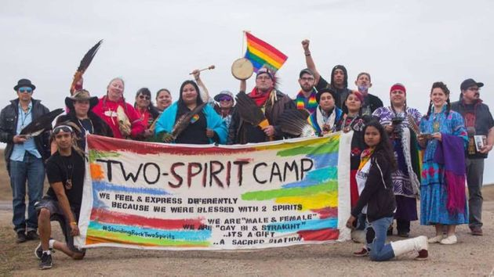
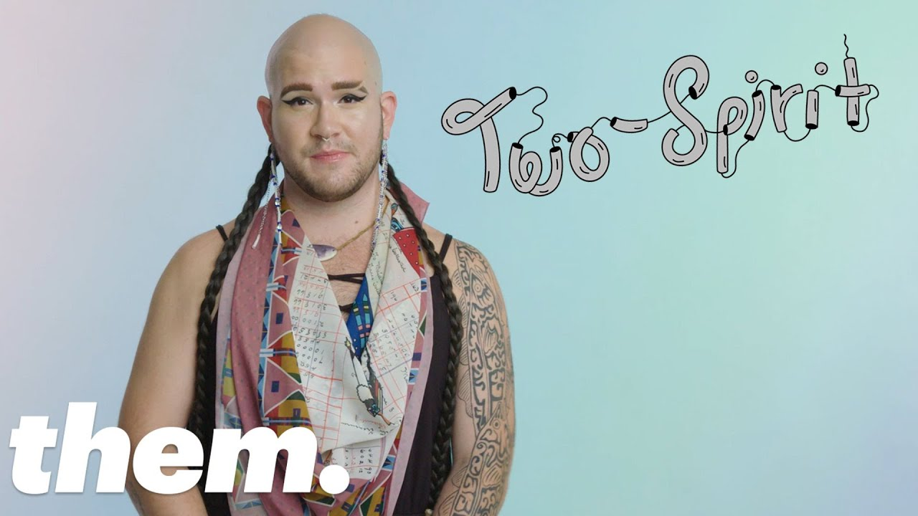
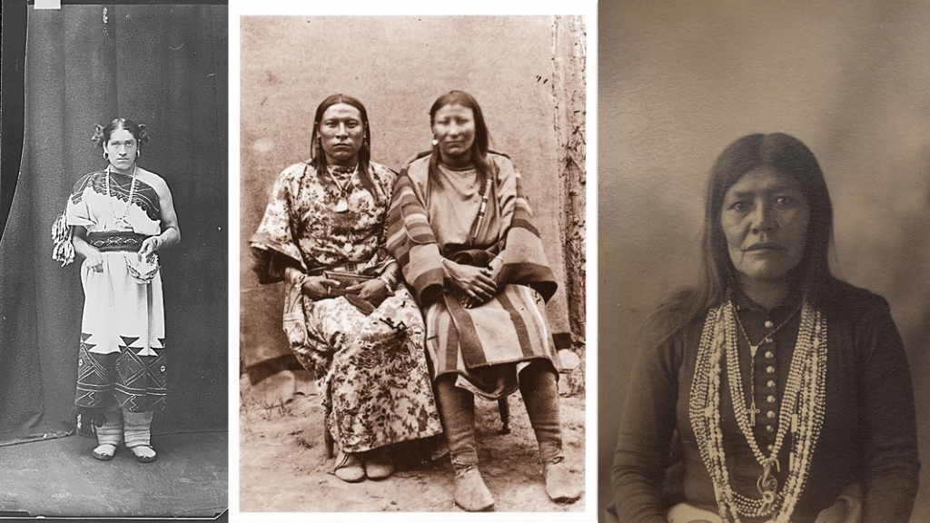
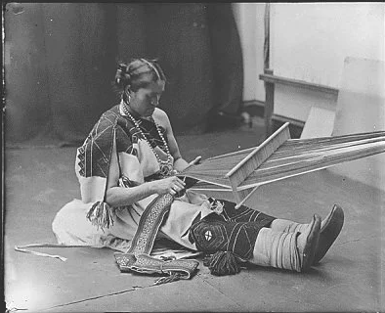
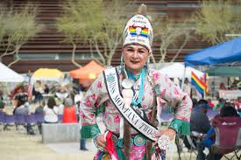
History of Two Spirit & Native LGBTQ People

Slide 4
Areas to Focus On:
1. Building and Physical Spaces
2. Policies and Procedures
3. Services Offered
4. Outside Partners

Slide 5
1. Building and Physical Space
Imagine you walk into a new office building. What are the first things you notice? What makes you feel welcome? Are there any red flags you pay attention to?
Now imagine you’re going to this office because you need them to help you with something (healthcare, advocacy, legal, etc.). Are there other things you pay attention to? What things might you notice that would make you feel confident that you would be treated with respect?

Slide 6
Making Your Space Welcoming for LGBTQ2S Survivors:
Bathrooms
Signage/brochures/posters
Registration or intake forms
Other visible signs you work with LGBTQ2S survivors

Slide 7
2. Policies and Procedures
Clarify and affirm access to services.
Ensure anti-discrimination policies include sexual orientation and gender identity.
Update language in policies so that they are gender neutral.
Establish protocol for addressing problematic behavior/language (for staff and survivors).

Slide 8
Policies and Procedures
“A recipient may not make a determination about services for one [survivor] based on the complaints of another [survivor] when those complaints are based on gender identity.”
–U.S. Department of Justice, 2014

Slide 9
3. Direct Services
Staff training:
Familiarity with terminology.
Understanding of unique issues LGBTQ2S survivors face.
Clear expectations for respectful interactions with LGBTQ2S survivors.
Guidance around addressing conflict between survivors on the basis of gender identity or sexual orientation.
Provide training opportunities at least once a year.

Slide 10
Helpful Terminology
Two Spirit
Gay
Lesbian
Bisexual
Transgender
Queer
Pansexual
Questioning
Asexual
Aromantic
Genderqueer
Nonbinary
Gender non-conforming
Cisgender
Intersex
And many more…….

Slide 11
Gender Pronouns
Ask how survivors would like to be addressed!

Slide 12
4. Ensuring Outside Partners are Inclusive
Meet with healthcare providers and SANEs to learn about their training and see whether they feel confident and comfortable working with LGBTQ2S individuals.
Verify tribal codes and other applicable laws are inclusive of violence against LGBTQ2S survivors.
Strategize with judges, prosecutors, etc. ahead of time about how to respectfully work with transgender survivors.

Slide 13
Ensuring Outside Partners are Inclusive
Meet with law enforcement to understand how their training and policies guide their work with LGBTQ2S survivors.
Discuss how law enforcement would document a transgender or nonbinary survivor in their reports.
Check with mental health practitioners in your area to see if any have experience working with LGBTQ2S individuals.

Slide 14
Advocate Response:
You work at the shelter as an advocate. Alisha is a trans woman who is staying at the shelter, and you think everything is going well. One day you’re facilitating a support group, and you overhear some of the other survivors talking meanly about Alisha, misgendering her (using he/him pronouns), talking about how Alisha is secretly a man, and threatening to go beat her up because they don’t want “someone like that” around their kids.
What do you do?
Are there any policies that would help guide your response?
What happens if you try to talk to them, but they continue harassing Alisha?
What could be done to try to prevent situations like this from escalating or happening in the first place?

Slide 15
Remember:
Your efforts to make your agency inclusive for LGBTQ2S survivors should include a comprehensive look at their needs and your advocacy.

Slide 16
Minnesota Indian Women’s Sexual Assault Coalition
Contact Information
Amanda Watson
ajwatson2015@gmail.com
1619 Dayton Ave, Suite 202* St. Paul, MN 55104 Tel 651-646-4800 | www.miwsac.org
This project was supported by Grant No. 2017-TA-AX-K025 awarded by the Office on Violence Against Women, U.S. Department of Justice. The opinions, findings, conclusions, and recommendations expressed during the meeting do not necessarily represent the official position or policies of the U.S. Department of Justice, Office on Violence Against Women.

