Slide 1
Presentation by the Grants Financial Management Division
New Grantee Orientation:
FY 2019 Tribal Affairs Division
Breakout Session: Financial Workshop
February 2020

Slide 2
Welcome and Introductions
Grants Financial Management Division (GFMD)
How to contact us --
OVW GFMD Helpdesk:
1-888-514-8556
Fax: 202-514-7045
OVW.GFMD@usdoj.gov
OVW GMS technical assistance (other than password resets):
OVW.GMSSupport@usdoj.gov or
1-866-655-4482

Slide 3
Grants Financial Management Training
Online Training
Basic grants financial management course
Online, no limitation for registration
Register with your vendor and award number
One year to complete the course
Approximately 14-16 hours to complete
Final exam is optional
https://ojpfgm.webfirst.com/

Slide 4
Setting Up
Your Award

Slide 5
Setting Up Your Award
Policy for steps to take when award is received:
Create a Grant File (hard or electronic)
Review Special Conditions
Set up (new) cost center in accounting system
Set up tracking of Budgeted vs. Actual Expenditures
Require Source Documentation

Slide 6
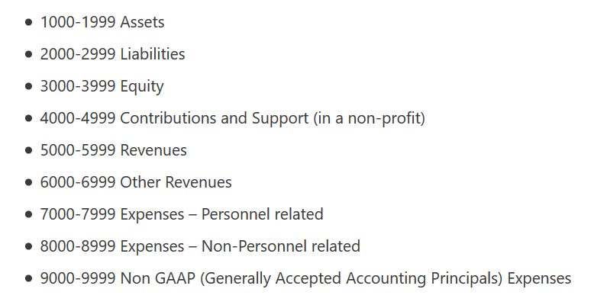
Setting Up Your Award
Set up a new cost center (assuming a NEW award number) in the accounting system to ensure funds are able to be tracked separately from all of funds
Set up a new cost center/activity code for each new grant
Example – 2018 OVW Legal Assistance for Victims “-201”
-- 2018 OVW Tribal Coalitions Program (assuming a 2018 award #) “-202”
Account 7220 – Salaries and Wages
7220 – 201 - Salaries and Wages – 2018 OVW Legal Assistance for Victims 7220 – 202 - Salaries and Wages – 2018 OVW Tribal Coalition Program

Slide 7
Setting Up Your Award
Track Budgeted vs. Actual Expenditures
Once the budget has been approved by OVW, set up a system to track and compare the approved budgeted expenditures with the actual expenditures
In your financial accounting system
Excel chart
Review on a regular basis (monthly)
Program and Finance staff should work closely together to monitor programmatic and financial progress of your award(s)

Slide 8
Setting Up Your Award
Track Budgeted vs. Actual Expenditures
Sample Tracking -
2018 OVW Comprehensive TA Program - Project Period 10/1/2018 - 9/30/2020
Grant and Budget Categories | Approved Budget | Actual Expenditures as of 12/31/2018 | Available Balance (Deficit) of Budget | Percentage of Budget Expended
Personnel | $325,468.00 | $38,693.57 | $286,774.43 | 11.9%
Fringe Benefits | $90,557.00 | $11,002.47 | $79,554.53 | 12.1%
Travel | $23,549.00 | $5,439.91 | $18,109.09 | 23.1%
Equipment | $0.00 | $0.00 | $0.00
Supplies | $21,691.00 | $3,507.75 | $18,183.25 | 16.2%
Consultants/Contracts | $83,950.00 | $2,350.00 | $81,600.00 | 2.8%
Other Costs | $79,785.00 | $9,212.67 | $70,572.33 | 11.5%
Indirect Costs | $0.00 | $0.00 | $0.00
Total Project Amount | $625,000.00 | $70,206.37 | $554,793.63 | 11.2%

Slide 9
Policies
and
Procedures

Slide 10
Policies and Procedures
Very common monitoring finding that organizations have incomplete, out of date, and inadequately enforced policies and procedures.
Can’t stress enough the importance of having good policies and procedures.

Slide 11
Policies and Procedures
Topics should include –
Conflicts of Interest
Cost Allocation/Methodology
Segregation of Duties
Cash Management
Personnel and Time and Attendance
Travel
Subrecipient/Contractor Determinations
Procurement
Reporting
Subrecipient Management and Monitoring
Equipment and Inventory
Records Retention
Conference Costs

Slide 12
Policies and Procedures
Segregation of Duties – having more than one person required to complete a task - authorization, custody, record keeping and reconciliation
Nonprofits often have few staff but duties must be spread out to accomplish separation of duties
Very important step to take in order to prevent fraud

Slide 13
Policies and Procedures –
Example of Segregation of Duties for Cash Management (see handout)
Finance Director receives unopened bank statement; reviews for unusual or unexplained items and completes reconciliation within stated timeframe
Finance Director is NOT an authorized check signer
Completed Bank Reconciliation along with bank statement and other documentation provided to Exec Dir for review and approval

Slide 14
Personnel and
Time & Attendance
Policies and
Procedures

Slide 15
Personnel and Time & Attendance
Time/Effort clearly documented
→ timesheets and activity reports
Amounts charged match documentation
Charge based on actuals (not budgeted)
Account for total activity of employee (Federal and Non-Federal) for all funding sources
Follow written policies and procedures
Internal controls to assure accuracy
Contact ovw.gfmd@usdoj.gov for a sample timesheet

Slide 16
Personnel and Time & Attendance
Policies should include –
Hiring Process
Job Announcements
Resume review, determination of qualification, interview and selection process (conflict of interest policy)
Job Descriptions
Salary Decisions (reasonable compensation)
Job classifications (Exempt, non-exempt, full-time, part-time, temporary, etc.)
Personnel Records (storage and access)

Slide 17
Personnel and Time & Attendance
Policies continued–
Schedule/Telework
Absences and Leave
Fringe benefits
Overtime
Timekeeping process
Timesheets – Excel, online system, etc.
Expectations for completing timesheet
Due date
Review and approval process
Performance Reviews
Termination

Slide 18
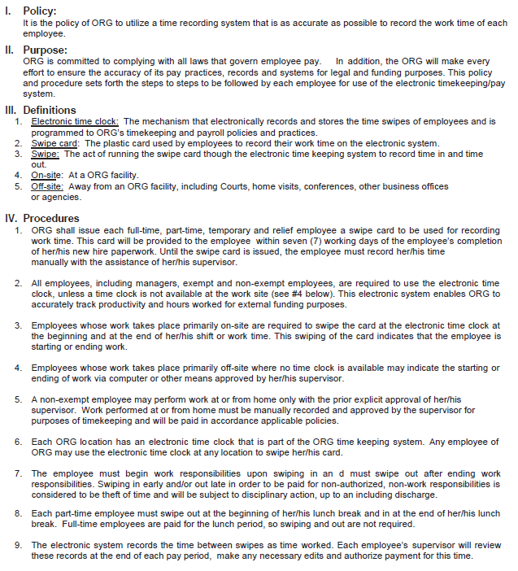
Personnel and Time & Attendance
Sample excerpt from “Recording of Time” Policy

Slide 19
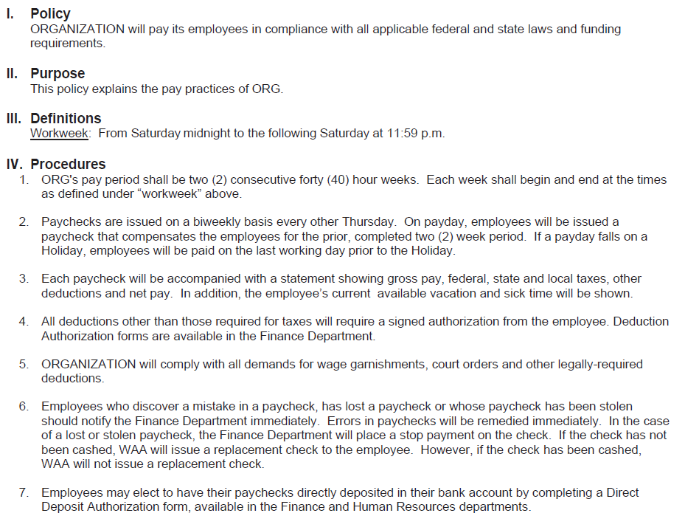
Personnel and Time & Attendance
Sample “Pay Practices” Policy

Slide 20
Personnel and Time & Attendance
Fringe Benefits
Examples: Social Security, Medicare, Health and Dental Insurance, Unemployment Insurance, Long/Short Term Disability, Retirement Contributions
Actual costs associated with employees working directly on the project
Charges should be proportional to percent of time spent on project
Follow organizational policy
Consistent for Federal and non-Federal funded positions
COLA and Merit increases consistent for all staff

Slide 21
Resources

Slide 22
Resources
Electronic Code of Federal Regulations http://www.ecfr.gov/cgi-bin/text-idx?tpl=/ecfrbrowse/Title02/2cfr200_main_02.tpl
OVW Solicitation Companion Guide
https://www.justice.gov/file/29686/download
Link to DOJ Financial Grants Management Guide https://www.justice.gov/ovw/grantees
Creating a Budget: Training for OVW Applicants https://www.justice.gov/ovw/video/creating-budget
OVW Financial Management Practices http://www.resourcesharingproject.org/ovw-financial-management-practices

Slide 23
Tribal Affairs Division – Solicitation Links
Coordinated Tribal Assistance Solicitation - Tribal Governments Program (Purpose Area #5)
https://www.justice.gov/ovw/page/file/1120761/download
Grants to Tribal Domestic Violence and Sexual Assault Coalitions
https://www.justice.gov/file/1148966/download
Tribal Sexual Assault Services Program (TSASP)
https://www.justice.gov/ovw/page/file/1124276/download
Grants to Tribal Governments to Exercise Special Domestic Violence Criminal Jurisdiction
https://www.justice.gov/ovw/page/file/1135686/download

Slide 24
Final Questions
and Answers

